Slide 1
Weekly updates - 08/23/2021 - AI Institute
Progress made last week
- Reviewed 130 reports file,
- Reviewed Material Master User manual documentation
- Drafted an initial conceptual design for feedback
Plan for this week
- Continue to review the Zgrve and 130 reports and working to understand the header definitions
- Continue Identify important fields for Material Planning
- Continue revising ER diagram
- Prepare data dictionary to create database
- Continue to improve conceptual design

Slide 2

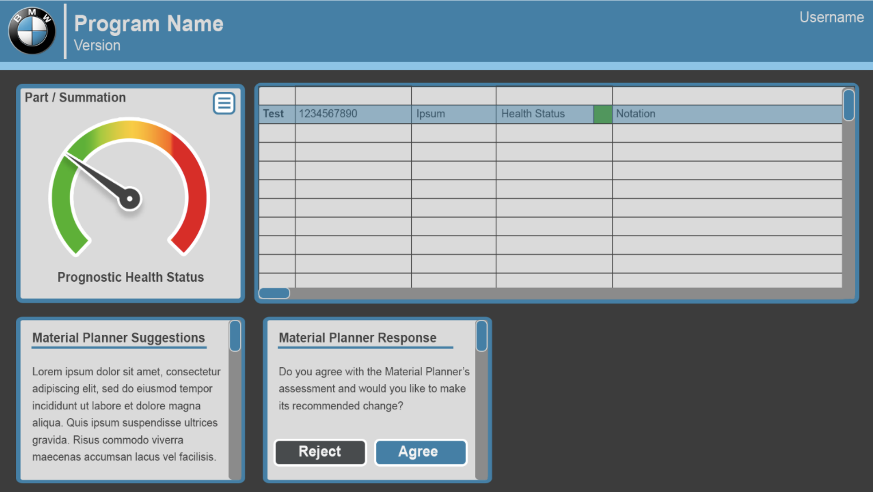





Conceptual design
Parts DB
Fetch and Retrieve Part Info
Dashboard
A
B
H
Get Recommendation
Fetch Part Info
E
Make Recommendation
Material Confi.
C
D
G
Run Forecast Model
Fetch Forecast Model
Parts
Forecast
Model
F
Fetch Rulesets
Recommendation
Decision & Reason
Material Trans.
AI Material Planner Assistant
Rule sets and Business logic

Slide 3
# | Action | Description
A | Fetch Part Info | Planning Assistant queries Parts Data Source for all part information.
B | Retrieve Part info | Planning Assistant Stores part information as a local data set.
C | Run Forecast Model | Planning Assistant feeds Part information to the forecast model.
D | Fetch Forecast Model | Recommendation engine retrieves current Forecast model variables.
E | Fetch Part Info | Recommendation engine retrieves part information.
F | Fetch Rulesets | Retrieve Rules and business logic from Rulesets DB
G | Make Recommendation | Recommendation engine generates recommendation.
H | Get Recommendation | Recommendation, Decision, and Reason is returned from Assistant.

Slide 4
Attributes changes frequently
(Material Transactions)
Attributes do not change frequently
(Material Config./ Material Master)
DepReq - Dependent Requirement, Reqmt of Stck Qty, based on Forecast and Firmed Orders
IndReq - Order Forecast of stck
Safety
Stck
Safe
Time
IndReq
DepReq
StckDS*
(in days)
Planning Time Fence (in days)
MRP
Type
Available
Qty
has
MRP
Area
Material (Stck)
Inventory
Material*
(Part)
ShipNt
Available Inventory at warehouse
Plant
ShipNt - Ship Note, Num of stck in transit
Available Inventory at Plant
Material
Type
Material ID, Desc.
Lot size
SchAgr
generate
Planning Calendar
The quantity of stck we are expecting to be picked up from Supplier. It will be delivered on a date.
Exception

Slide 5

MRP #
Vendor Name
Vendor #
0 %
100 %
Health
Status
Material
Planner
has
1..*
Supplier
(Vendor)
recommend
Responsible
supply
use
Output
1..*
Material
Planning
has
Material
(Part)
input
Material Inventory
input
use
Code #
generate
Exception
Desc.
Criticality
Level

